Slide 1
CSE 2102: Introduction to Software Engineering
Software Specification
ER Diagrams

Slide 2
ER Diagrams
Often used as a complement to Data Flow Diagrams (DFDs) to describe conceptual data models
Based on entities, relationships, attributes
They are the ancestors of class diagrams in UML
Describe how the data of a system is inter-related

Slide 3
Data Objects (Entities)
A person, place, concept, or thing which is represented in the system.
Examples:
  A report or display
  A telephone call
  An event (an alarm)
  A person
  An organization unit (Accounting department)
  A place (Warehouse)
  A file structure

Slide 4
Entity Type vs. Entity Instance
Entity type:
  A definition for a collection of entity “instances” that share the same properties.
  Employee(ID, Name, SS#,… Birthdate,….)
Entity instance:
  A physical data, a concrete occurrence of a given entity type
  (1234, John Smith,…. 08/31/1972,..)
  (5678,Marie Joe,…. 07/31/1968,..)
Compare this with class and object in OO paradigm.

Slide 5
Entities
Represented by a rectangle
Person
Car

Slide 6
Weak Entities
A weak entity is one which cannot exist without the existence of some
other entity. The entity on which a weak entity depends is also referred
to as a strong entity.
For example, consider two entities: employees and dependents.
Dependents have no existence without employees.

Slide 7
Attributes
Define properties of a data object
Represented by an oval attached to an entity
Name
Address
Age
SSN
Person

Slide 8
Attributes (contd..)
Body
Type
Make
Model
ID#
Color
Owner
Car

Slide 9
Single-valued vs. Multi-valued Attributes
Single valued attributes – For each instance of an entity, the attribute can take only one value:
  For example, Name, SS# of entity person.
Multiple valued attributes -- for each instance of an entity the attribute may take multiple values.
  For example, Cars owned by a person.
Entity “City” in a travel reservation system:
  Single-valued attributes: Name of the city, airport code.
  Multiple-valued attributes: Airlines serving the city, hotels, airports serving the city.

Slide 10
Notation
Employee
Name
Single-valued attribute
Employee
Skills
Multi-valued attribute

Slide 11
Types of Attributes
Can name a data object:
  Car: Lexus, Chevy, BMW, Ford
  Person: Joe, Sally, Mark..
Describe a data object:
  Car: Type, Color
  Person: Height, weight
Refer to another data object:
  Car: Owner
  Person: Car

Slide 12
Types of Attributes
Remember, which attributes to consider depends on the goals and functions of the system in which the entity is being represented. This classification scheme relies on the purpose of the attribute.
Entity “City” in travel reservation system:
  Name a data object: Name of the city, airport code of the city
  Describe a data object: Latitude, longitude, rainfall, temperature.
  Refer to another data object: Key tourist attractions, hotels, taxi companies in the city.

Slide 13
Identifier Attributes
Attribute becomes “key” when we want to find an instance of the object
Example:
  For the “Car” data object, the key might be “ID#” attribute
  For the “Person” data object, the key might be ?
Keys often must be unique, but not always

Slide 14
Relationships
A relationship is a logical association between two types of entities.
Consider books and bookstores:
  Bookstore orders books
  Bookstore displays books
  Bookstore stocks books
  Bookstore sells books
  Bookstore returns books
Represented by a diamond

Slide 15
Relationships: Example
Orders
Bookstore Books

Slide 16
Relationships: Example
NAME
AGE
STUDENT
GENDER
ENROLLED_IN
SUBJECT
CLASS
COURSE_ID
MAX_ENROLLMENT

Slide 17
Relationships: Cardinality
How many occurrences of object x are related to how many occurrences of object y.
  One to One (1:1)
  One to Many (1:N)
  Many to Many (M:N)
Doesn’t indicate whether one data object must participate in the relationship.

Slide 18
Relationships: Modality
Modality = 0, if relationship is optional
Modality = 1, if relationship is mandatory

Slide 19
Cardinality & Modality: Notation
E1
R
E2
(min,max)
(min,max)
Modality Cardinality
0 – Partial 1 – One
1 – Mandatory M – More than one

Slide 20
Cardinality & Modality: Notation (contd..)
Places
Customer
R
Order
(0,M)
(1,1)
A customer may place (modality 0) zero to many orders (cardinality M)
An order is placed by one and only customer (modality and cardinality 1).

Slide 21
Cardinality Notation
Assume that modality is always 1, that is, the participation of objects
is mandatory
Places
Customer
Order
One customer places many orders.
Arrow pointing towards an entity which has a single object participating
in the relationship

Slide 22
Relationship Cardinalities
1
1
A R B is one to one
A
R
B
1
m
A
R
B
A R B is one to many (one A, many B)
n
1
A
R
B
A R B is many to one (one B, many A)
m
n
A
R
B
A R B is many to many (many A & B)

Slide 23
Degree of Relationships
Unary relationship:
  A relationship exists within one entity type.
Binary:
  A relationship exists between two entity types.
Ternary:
  A simultaneous relationship exists among three entity types

Slide 24
Degree of Relationships (contd..)
Unary relationship
Employee
Is_Manager_Of
Assembly Part
Is_Composed_Of

Slide 25
Degree of Relationships (contd..)
Binary relationships
Most relationships fall in this category
Teaches
Faculty
Course
Manages
Manager
Project

Slide 26
Degree of Relationships (contd..)
Ternary relationships
Relationships that exist between three entities
Warehouse
Vendor
Product
Ships

Slide 27
Finding Entities and Relationships
Identify the system information:
  User interviews
  Paper and screen documents
  Previous system documentation
Identify entities:
  Heuristics
  Analysis of English grammar → Entity-Relationships

Slide 28
English Grammar – Rule #1
English
Proper Noun
Common Noun
Transitive verb
Intransitive verb
Adjective
Adverb
ERD
Entity (“Name” of an entity)
Entity or entity-type
M-ary relation (M>1)
Unary relationship or attribute
Value
Attribute of an entity
Attribute of a relationship

Slide 29
English Grammar – Rule #1
Consider two sentences of the form:
“There are ….. X in Y”
Or
“Y has …. X”
X Y
Example:
There are more than 200 employees in every department.
Every department has more than 200 employees
Y X
Entities: X and Y

Slide 30
English Grammar: Rule #2
If the English sentence says, “The X of Y is Z”
Rule #2: Y is an entity
Rule #3: X is either an Attribute or an Entity depending on what type
of “Z” it is.
Rule #4a: If “Z” is a proper noun, then X is a relationship between Y
and Z.
Rule #4b: Otherwise, X is an attribute of Y.

Slide 31
English Grammar: Rule #2 (Examples)
The X of Y is Z
The birthdate of the student is 12/08/80.
Attribute(X) Entity(Y) not a proper noun (Z)
The advisor of John Smith is Dr. Greene
Relationship(X) Entity (Y) Proper Noun(Z)
The X of Y is Z

Slide 32
ER Diagrams: Summary
ER diagrams very similar to UML class diagrams:
  An entity is similar to a class,
  Attributes are the similar to variables in a UML class.
  ER diagrams often referred to as precursors to UML class diagrams.
Semi-formal notation
Widely used:
  Data-oriented applications
  Easy to understand, even by nonspecialists
  Easy to verify that requirements are met
  Supported by existing tools

Slide 33
ER Diagram: Example
Consider an example of a course registration and student advising system. This system maintains information regarding the courses offered each semester as well as the advisors assigned to each student. Each course has a number of students enrolled, while each student can register for a number of courses. A course is taught by a single instructor. Each instructor teaches only one course per semester. In addition, an instructor is responsible for advising several students. Each student is assigned a single advisor. Draw an ER diagram for the course registration and student advising system.

Slide 34
ER Diagram: Example
What are the entities and the relationships among them?
  Relationships can be many-to-many, many-to-one, one-to-many, and one-to-one.
Three entities – course, student, and instructor:
  Course – Instructor is one-to-one
  Instructor – Student is one to many
  Course – Student – many to many

Slide 35
ER Diagram: Example
ER diagram, the arrow points to that entity which has one instance participating in a relationship:
  Course ➔ instructor: Both entities have exactly one instance participating, so both have arrows pointing towards them.
  Instructor ➔ student: Only one instance of the instructor, an arrow pointing towards the instructor.
  Course ➔ Student: many instances of student and many instances of courses, so there are no arrows.

Slide 36
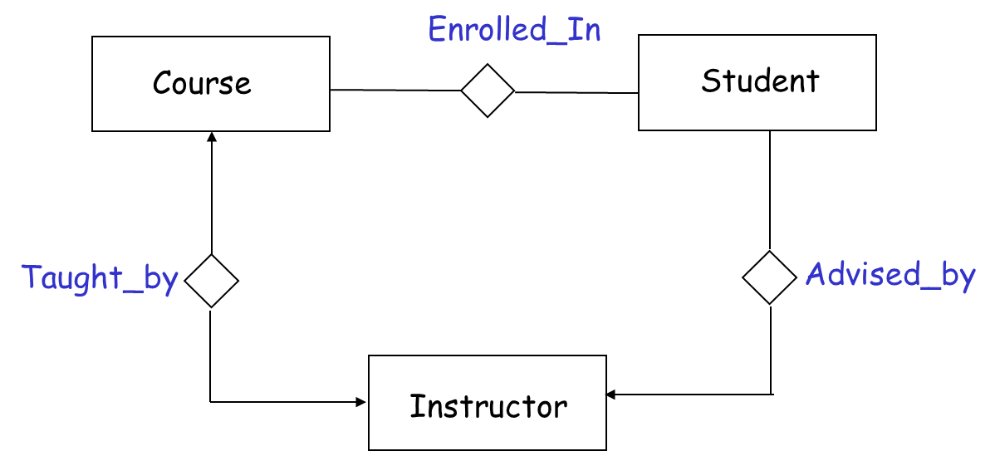
ER Diagram: Example

